Slide 1
Lecture 04 - Component Segmentation
Prof. André Gustavo Hochuli
gustavo.hochuli@pucpr.br
aghochuli@ppgia.pucpr.br
Notes:
Prof. André Hochuli

Slide 2
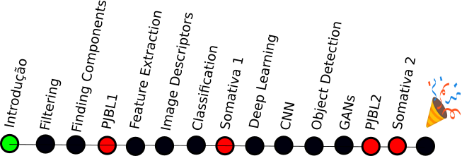
Topics
Discussion of Practice 03
Component Segmentation
Finding Connected Components
Filtering Components
Practice
License Plate Characters Segmentation
Computer Vision - Prof. André Hochuli
Lecture 04
Notes:
Prof. André Hochuli

Slide 3

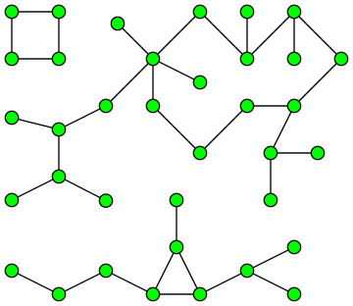


Component Segmentation
A.K.A Connected Component Extraction, Blob Extraction, …..
Its application comes from Graph Theory
Social Networks
Biology
Pattern Recognition
Computer Vision - Prof. André Hochuli
Lecture 04
Notes:
Prof. André Hochuli

Slide 4


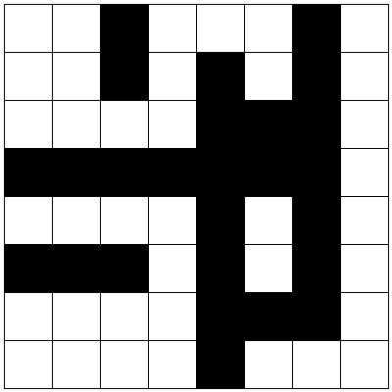
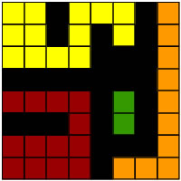
Connected Component Labelling
Analyzes the non-zero pixel's neighborhood (foreground)
Label each connected pixel with a label (1,2,3,4….)
Kernels:
4-Neighboors
8-Neighboors
Computer Vision - Prof. André Hochuli
Lecture 04
Notes:
Prof. André Hochuli

Slide 5

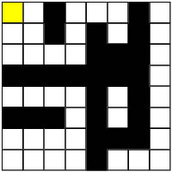
Row by Row Algorithm
Sliding a connectivity kernel , row by row ( 2 passes)
If the center falls in a non-zero pixel, label it!
Labeling:
If there are no labeled pixels connected, attribute a new label
Otherwise, attribute to it the neighbor´s label.
A Union-Find structure control adjacent labels (Union-Find)
Pass #1:
Row #1
Computer Vision - Prof. André Hochuli
Lecture 04
Notes:
Prof. André Hochuli

Slide 6

Row by Row Algorithm
Sliding a connectivity kernel , row by row ( 2 passes)
If the center falls in a non-zero pixel, label it!
Labeling:
If there are no labeled pixels connected, attribute a new label
Otherwise, attribute to it the neighbor´s label.
A Union-Find structure control adjacent labels (Union-Find)
Pass #1:
Row #1
Computer Vision - Prof. André Hochuli
Lecture 04
Notes:
Prof. André Hochuli

Slide 7
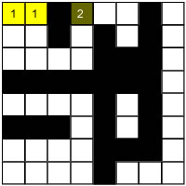
Row by Row Algorithm
Sliding a connectivity kernel , row by row ( 2 passes)
If the center falls in a non-zero pixel, label it!
Labeling:
If there are no labeled pixels connected, attribute a new label
Otherwise, attribute to it the neighbor´s label.
A Union-Find structure control adjacent labels (Union-Find)
Pass #1:
Row #1
Computer Vision - Prof. André Hochuli
Lecture 04
Notes:
Prof. André Hochuli

Slide 8
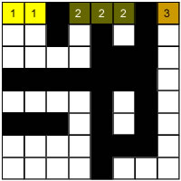
Row by Row Algorithm
Sliding a connectivity kernel , row by row ( 2 passes)
If the center falls in a non-zero pixel, label it!
Labeling:
If there are no labeled pixels connected, attribute a new label
Otherwise, attribute to it the neighbor´s label.
A Union-Find structure control adjacent labels (Union-Find)
Pass #1:
Row #1
Computer Vision - Prof. André Hochuli
Lecture 04
Notes:
Prof. André Hochuli

Slide 9
Row by Row Algorithm
Sliding a connectivity kernel , row by row ( 2 passes)
If the center falls in a non-zero pixel, label it!
Labeling:
If there are no labeled pixels connected, attribute a new label
Otherwise, attribute to it the neighbor´s label.
A Union-Find structure control adjacent labels (Union-Find)
Pass #1:
Row #1
Computer Vision - Prof. André Hochuli
Lecture 04
Notes:
Prof. André Hochuli

Slide 10
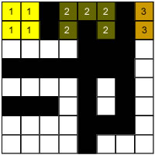
Row by Row Algorithm
Sliding a connectivity kernel , row by row ( 2 passes)
If the center falls in a non-zero pixel, label it!
Labeling:
If there are no labeled pixels connected, attribute a new label
Otherwise, attribute to it the neighbor´s label.
A Union-Find structure control adjacent labels (Union-Find)
Pass #1:
Row #2
Computer Vision - Prof. André Hochuli
Lecture 04
Notes:
Prof. André Hochuli

Slide 11
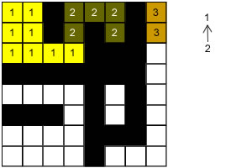
Row by Row Algorithm
Sliding a connectivity kernel , row by row ( 2 passes)
If the center falls in a non-zero pixel, label it!
Labeling:
If there are no labeled pixels connected, attribute a new label
Otherwise, attribute to it the neighbor´s label.
A Union-Find structure control adjacent labels (Union-Find)
Pass #1:
Row #3
Adjacent labels
Union-Find
Computer Vision - Prof. André Hochuli
Lecture 04
Notes:
Prof. André Hochuli

Slide 12
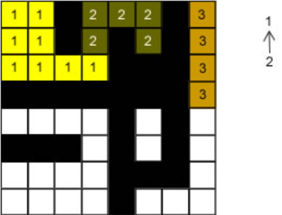
Row by Row Algorithm
Sliding a connectivity kernel , row by row ( 2 passes)
If the center falls in a non-zero pixel, label it!
Labeling:
If there are no labeled pixels connected, attribute a new label
Otherwise, attribute to it the neighbor´s label.
A Union-Find structure control adjacent labels (Union-Find)
Pass #1:
Row #4
Union-Find
Computer Vision - Prof. André Hochuli
Lecture 04
Notes:
Prof. André Hochuli

Slide 13
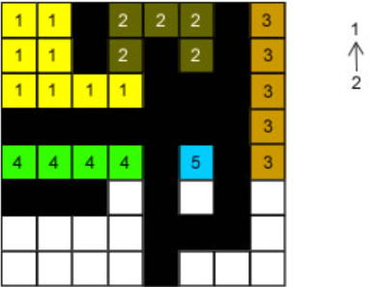
Row by Row Algorithm
Sliding a connectivity kernel , row by row ( 2 passes)
If the center falls in a non-zero pixel, label it!
Labeling:
If there are no labeled pixels connected, attribute a new label
Otherwise, attribute to it the neighbor´s label.
A Union-Find structure control adjacent labels (Union-Find)
Pass #1:
Row #5
Union-Find
Computer Vision - Prof. André Hochuli
Lecture 04
Notes:
Prof. André Hochuli

Slide 14
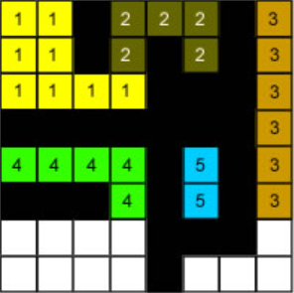
Row by Row Algorithm
Sliding a connectivity kernel , row by row ( 2 passes)
If the center falls in a non-zero pixel, label it!
Labeling:
If there are no labeled pixels connected, attribute a new label
Otherwise, attribute to it the neighbor´s label.
A Union-Find structure control adjacent labels (Union-Find)
Pass #1:
Row #6
Union-Find
Computer Vision - Prof. André Hochuli
Lecture 04
Notes:
Prof. André Hochuli

Slide 15
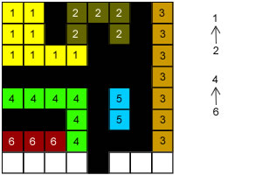
Row by Row Algorithm
Sliding a connectivity kernel , row by row ( 2 passes)
If the center falls in a non-zero pixel, label it!
Labeling:
If there are no labeled pixels connected, attribute a new label
Otherwise, attribute to it the neighbor´s label.
A Union-Find structure control adjacent labels (Union-Find)
Pass #1:
Row #7
Union-Find
Computer Vision - Prof. André Hochuli
Lecture 04
Notes:
Prof. André Hochuli

Slide 16
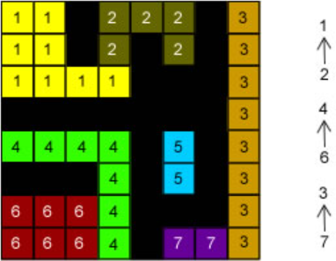
Row by Row Algorithm
Sliding a connectivity kernel , row by row ( 2 passes)
If the center falls in a non-zero pixel, label it!
Labeling:
If there are no labeled pixels connected, attribute a new label
Otherwise, attribute to it the neighbor´s label.
A Union-Find structure control adjacent labels (Union-Find)
Pass #1:
Row #8
Union-Find
Computer Vision - Prof. André Hochuli
Lecture 04
Notes:
Prof. André Hochuli

Slide 17
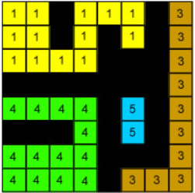
Row by Row Algorithm
Sliding a connectivity kernel , row by row ( 2 passes)
If the center falls in a non-zero pixel, label it!
Labeling:
If there are no labeled pixels connected, attribute a new label
Otherwise, attribute to it the neighbor´s label.
A Union-Find structure control adjacent labels (Union-Find)
Pass #2:
Resolve Union-Find
Union-Find
Computer Vision - Prof. André Hochuli
Lecture 04
Notes:
Prof. André Hochuli

Slide 18
Let’s Code!
In our pratice, we will implement an algorithm to segment characters in a license plate.
Besides, we will introduce the cv2.connectedComponent() that implements the component labeling method
Checkout it here: Lecture 04 - Finding Components.ipynb
Computer Vision - Prof. André Hochuli
Lecture 04
Notes:
Prof. André Hochuli

